Slide 1

Text Editor
MOJO DOJO
Group - 4
Batch - 28

Slide 2
CONTENT
1. Introduction
2. Innovations and Implementations
3. Themes like dark/light mode.
4. Ideas for Unique Platform Experience
5. Technology Stack Used
6. Team Member/Work Distribution
Text Editor
2

Slide 3
Introduction
3
Welcome to MOJO DOJO an innovative Java-based text editor designed to revolutionize the way developers interact with their code. Born from a collaborative effort of our team at Bennett University this project aims to deliver a seamless and enriching platform experience for programmers of all levels.
Join us on this journey as we redefine the boundaries of text editing software and pave the way for a new era of programming excellence. Together, let's write the next chapter in the story of software development with MOJO DOJO.
Welcome to the future of coding. Welcome to MOJO DOJO.
Text Editor

Slide 4
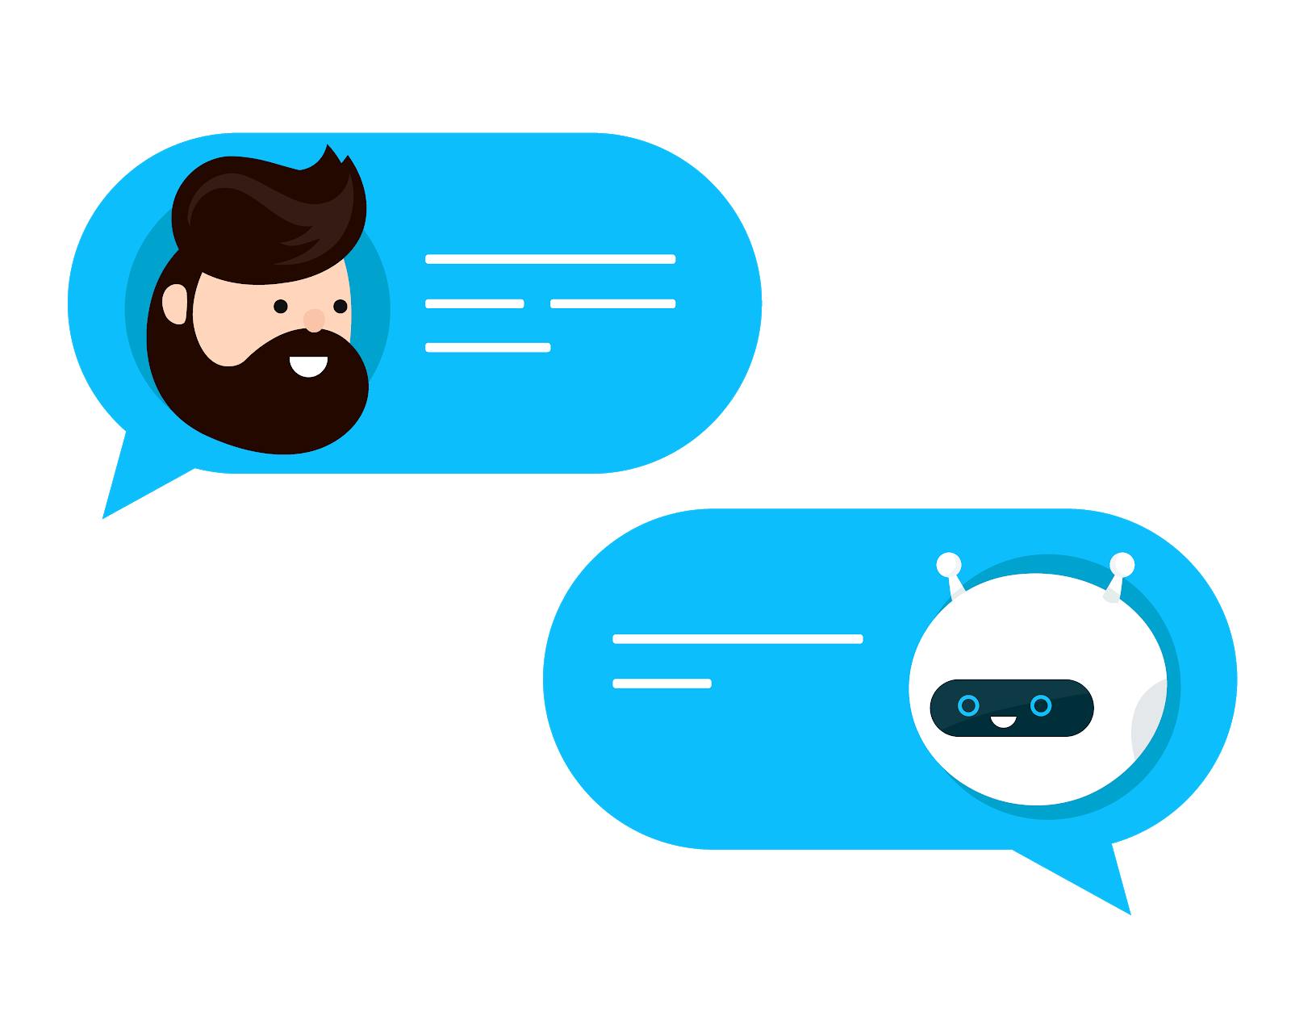
Innovations and Implementations
Chat Box for real time solutions
Text Generating AI integration
Multi-Themed workspace
Portable coding platform
Text Editor
4

Slide 5
Ideas for Unique Platform Experience
Seeking to provide a platform/workspace with real time chat and code simultaneously
Real-time Collaboration: Implement real-time collaboration features that enable multiple users to work on the same document simultaneously. You could use technologies like WebSockets to achieve this.
Cloud Integration: Enable seamless integration with cloud storage services such as Google Drive, Dropbox, or OneDrive. This would allow users to easily save and access their documents from anywhere and collaborate with others more efficiently.
Voice Typing: We will try to Integrate voice typing functionality, allowing users to dictate their text instead of typing it manually. This can be particularly useful for users with mobility issues or for quickly capturing thoughts without having to type.
Text Editor
5

Slide 6
Technology Stack Used
1. Java Technologies:
i. Spring Boot
ii. Servlet
Other Tech/Programming languages
i. HTML/CSS
ii. Java Core
Utilities/Software
i. Visual Studio Code
Text Editor
6

Slide 7
Team Members / Work Distribution
Avinash Yadav
E23CSEU0813
Frontend
AI Implementation
Atif Azeem
E23CSEU0836
Java Backend
Web Socket and API integration
Vishal
E23CSEU0834
Presentation
User Interface
Group - 4
Batch - 28

Slide 8
THANK YOU
Text Editor
8

